Slide 1
"Predictive Modeling of Handset Prices based on Features"
-Surabhi Patil

Slide 2
Introduction
This project focuses on predictive modeling of handset prices based on their features. With the increasing competition in the handset market, understanding the key factors influencing prices is crucial for manufacturers and marketers. The objectives of this project are:-
To develop a predictive model to estimate handset prices based on their features.
To identify the most significant features that affect handset pricing.
To provide actionable insights for handset manufacturers and marketers to refine their pricing strategies.

Slide 3
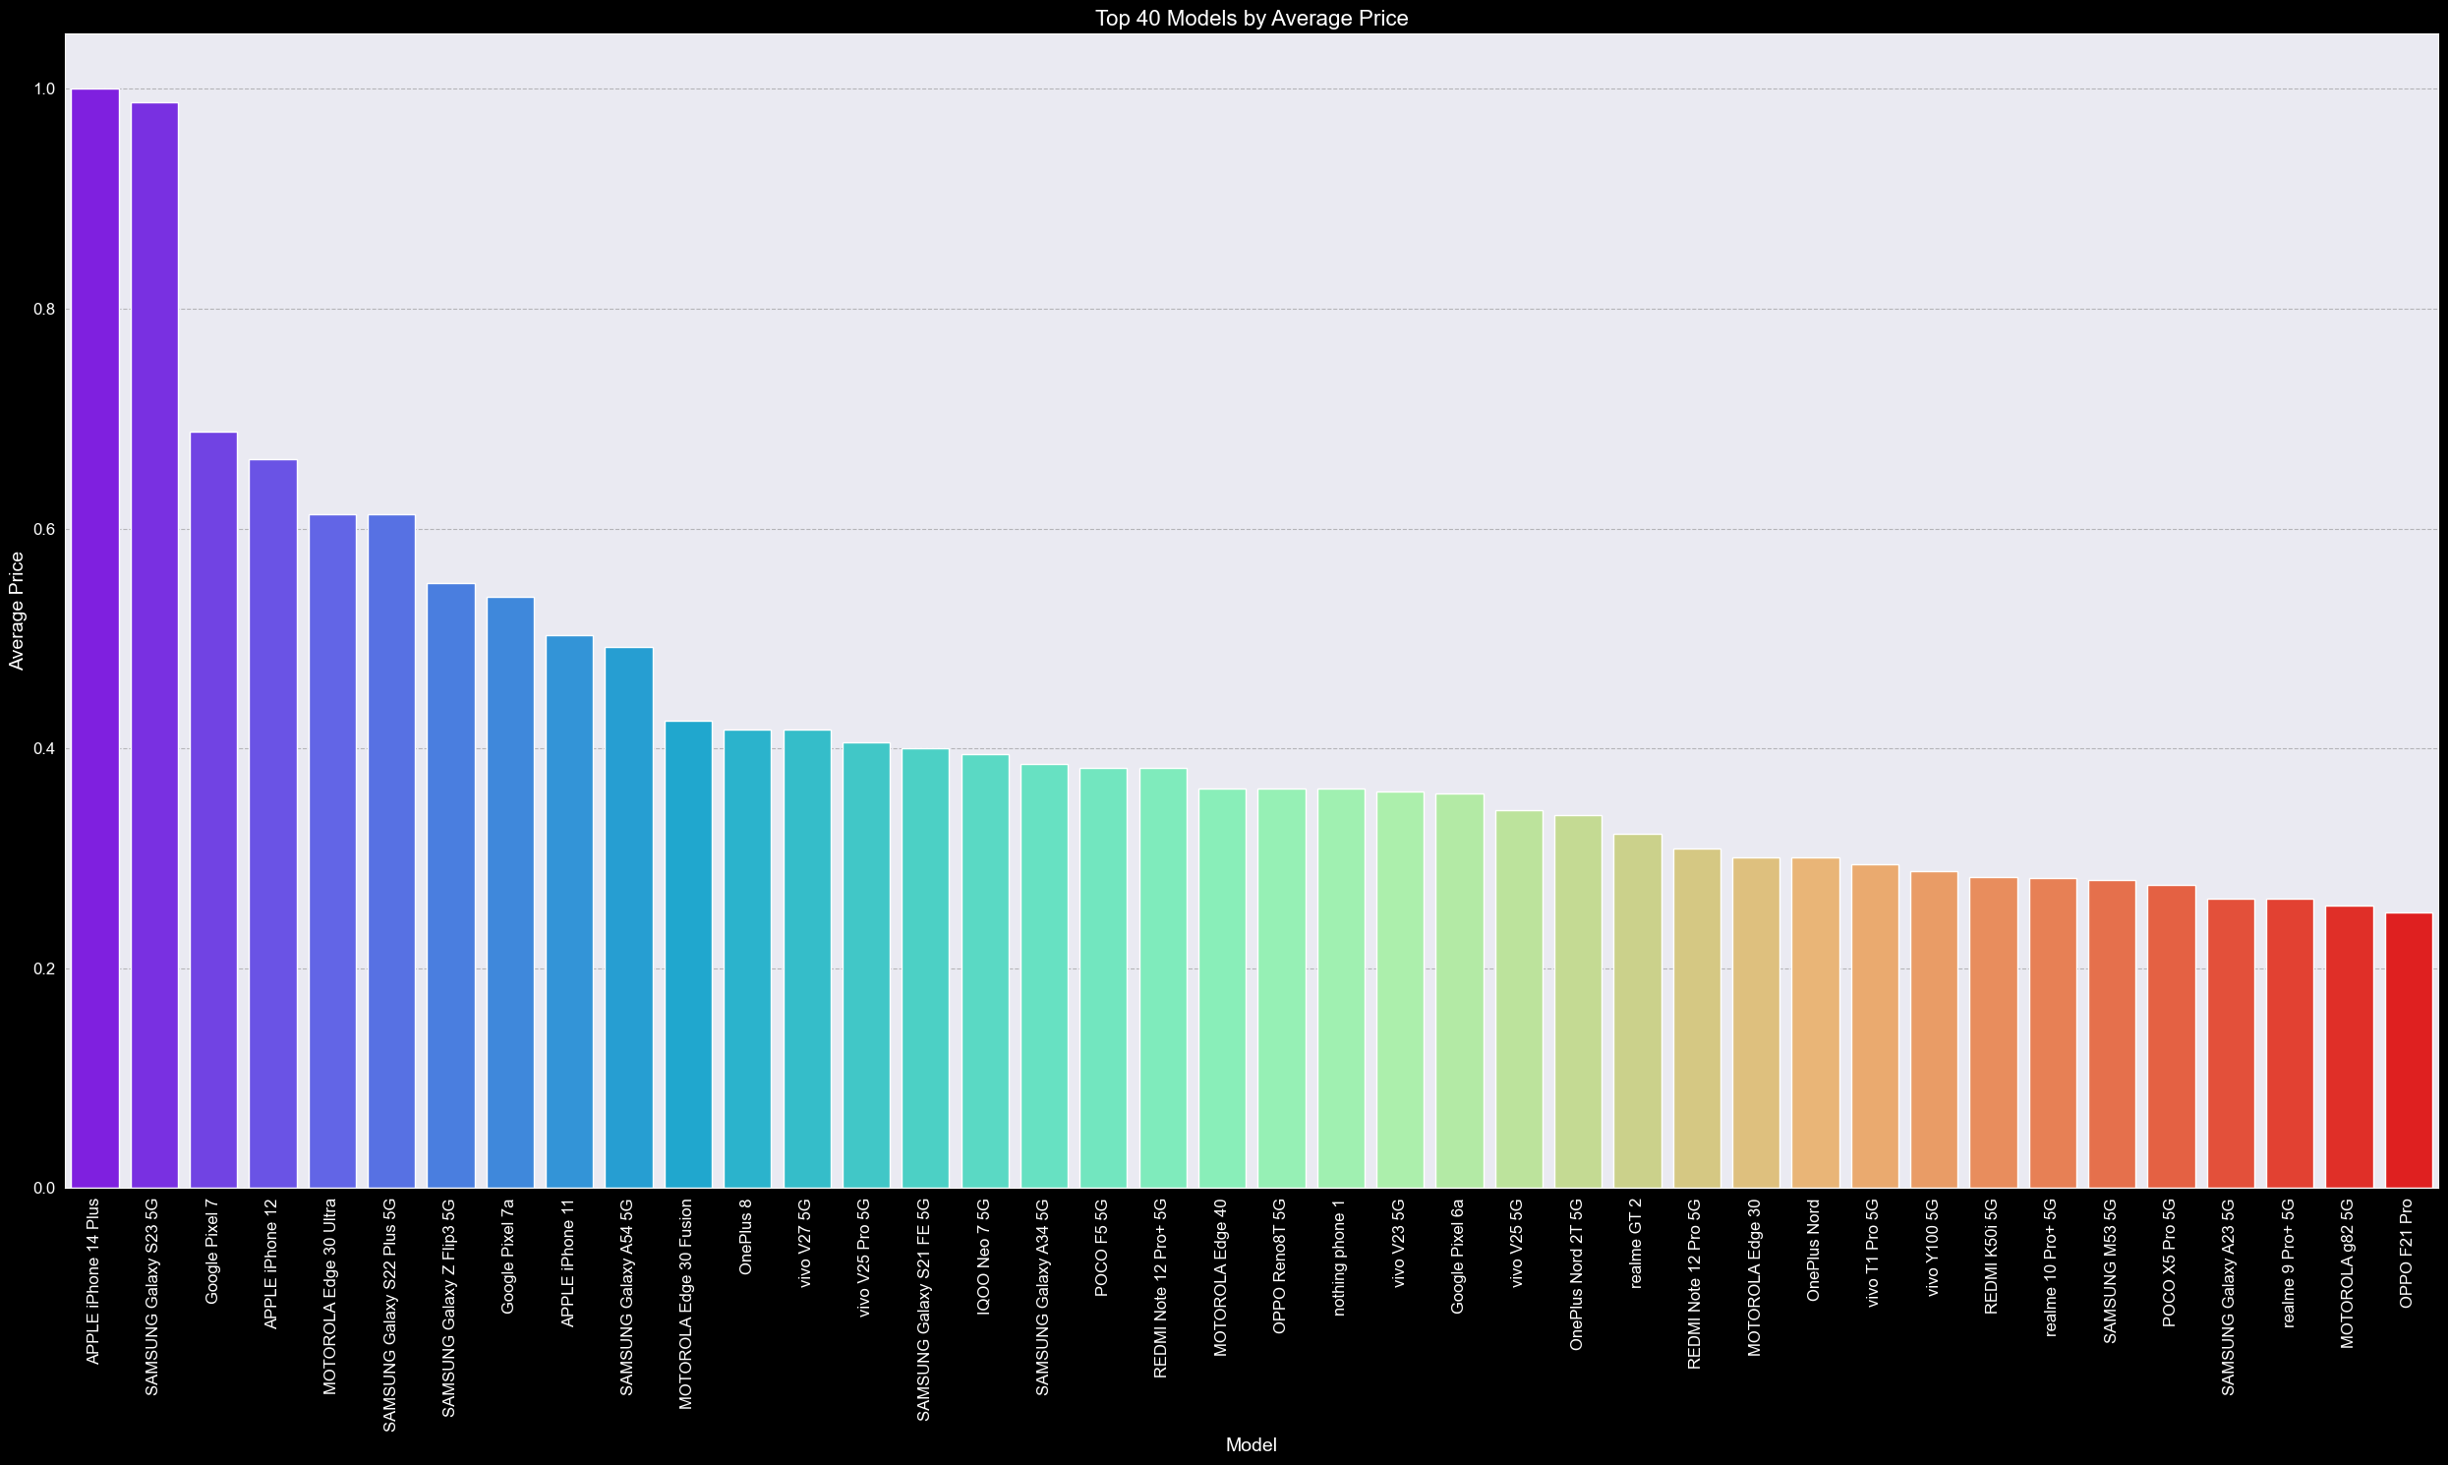
Top 40 Mobile models by average prices:

Slide 4
Top 5 Mobile Models by Average Price:
1. APPLE iPhone 14 Plus: ₹80,999
2. SAMSUNG Galaxy S23 5G: ₹79,999
3. Google Pixel 7: ₹55,999
4. APPLE iPhone 12: ₹53,999
5. MOTOROLA Edge 30 Ultra: ₹49,999
Key Observations:
- Apple and Samsung dominate the top 10 list.
- Average prices range from ₹40,332 to ₹80,999.
- Samsung has 4 models in the top 10, Apple has 3, and Google has 2.
- Motorola's Edge 30 Ultra ranks 5th.

Slide 5
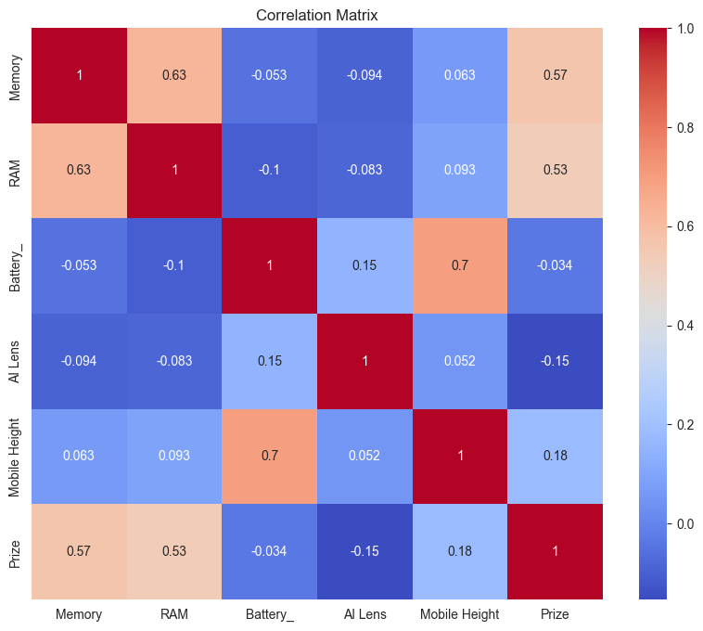
Correlation Between Features and Price :
1. Mobile Height: Moderate positive correlation (0.18). Taller mobiles tend to be more expensive.
2. AI Lens: Weak negative correlation (-0.15). The presence of AI Lens slightly decreases the price.
3. Battery: Very weak negative correlation (-0.034). Battery capacity has minimal impact on price.
4. RAM: Strong positive correlation (0.53). Higher RAM capacity significantly increases the price.
5. Memory: Strong positive correlation (0.57). Larger storage capacity strongly increases the price.
- Focus on RAM and memory as key price drivers.
- Consider Mobile Height as a contributing factor.
AI Lens and Battery capacity have a limited impact on price.
Note: This analysis was performed on the raw data before encoding.

Slide 6
Feature Importance
Feature importance is a crucial aspect of understanding how different features contribute to the predicted price of a mobile phone.
By analyzing feature importance, we can identify the most critical features that drive the price and inform pricing strategies
The top five features driving the price of a mobile phone are:
Model: With an importance score of 0.2989, the model is the most critical feature in determining the price.
Total Memory: Total memory is the second most important feature, with an importance score of 0.2366.
Battery Life: Battery life is the third most important feature, with an importance score of 0.1843.
Total Camera Resolution: Total camera resolution is the fourth most important feature, with an importance score of 0.1379.5. Processor_: Processor is the fifth most important feature, with an importance score of 0.0710.

Slide 7
Mid-Range Models
Balancing features and price, these models offer:-
Good processing power, memory, and storage
Decent camera capabilities
Sufficient battery life- Affordable prices
Vivo T2X 5G (₹20,000 - ₹25,000): 6GB RAM, 128GB storage, 48MP camera, 5000mAh battery
Vivo T1 44W (₹15,000 - ₹20,000): 4GB RAM, 64GB storage, 13MP camera, 5000mAh battery
Samsung Galaxy M32 (₹15,000 - ₹20,000): 4GB RAM, 64GB storage, 64MP camera, 6000mAh battery

Slide 8
High-End Models
These models offer advanced features
high-performance capabilities
premium designs
Redmi Note 12 Pro 5G (₹25,000 - ₹30,000): 8GB RAM, 256GB storage, 50MP camera, 5000mAh battery
Infinix Hot 30i (₹20,000 - ₹25,000): 8GB RAM, 128GB storage, 50MP camera, 5000mAh battery
Samsung Galaxy S21 (₹40,000 - ₹50,000): 12GB RAM, 256GB storage, 50MP camera, 4500mAh battery

Slide 9
Comparison of Memory & Camera Resolution Concerning Price
The analysis reveals a positive correlation between Total Memory and Price, indicating that as the total memory of a device increases, its price also tends to increase.
Similarly, a positive correlation is observed between Total Camera Resolution and Price, suggesting that devices with higher camera resolution are generally more expensive.
This relationship is likely due to the increased cost of manufacturing devices with higher memory capacity and better camera quality.

Slide 10
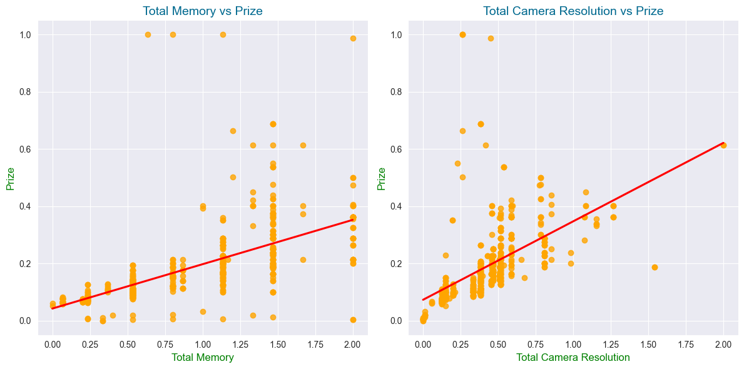

Slide 11
Comparison of AI Lens & Battery Concerning Price
The analysis also reveals a negative correlation between AI Lens and Price, indicating that devices with AI Lens tend to be less expensive.
Additionally, a negative correlation is observed between Battery Life and Price, suggesting that devices with longer battery life are generally less expensive.

Slide 12
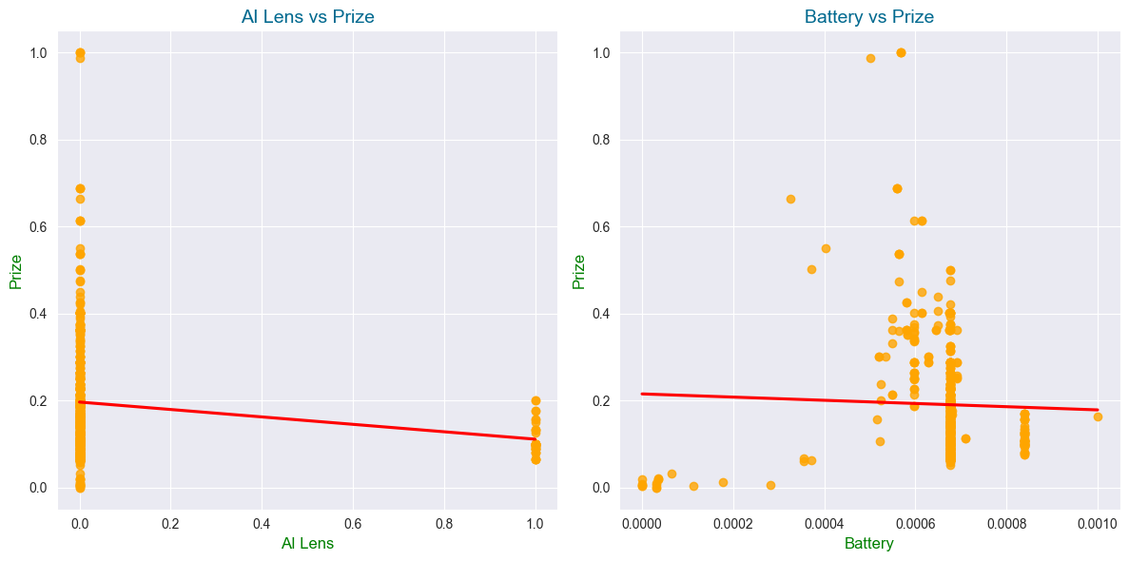

Slide 13

Total Memory of Models
1. Redmi Note 12 Pro 5G has the highest Total Memory: This model stands out from the rest with the highest Total Memory value.
2. Infinix HOT 30i,SAMSUNG Galaxy A14 5G,Realme C55 are close contenders: These models have high Total Memory values, indicating they are among the top models in terms of memory.
3. Mid-range models cluster around the middle: Models like Vivo T2X 5G, Vivo T1 44W, Redmi 10, Samsung Galaxy F14 5G, and Vivo Y16 have Total Memory values that cluster around the middle, indicating a grouping of mid-range models.
4. Samsung Galaxy F13 has the lowest Total Memory: This model has the lowest Total Memory value among all the models plotted.

Slide 14
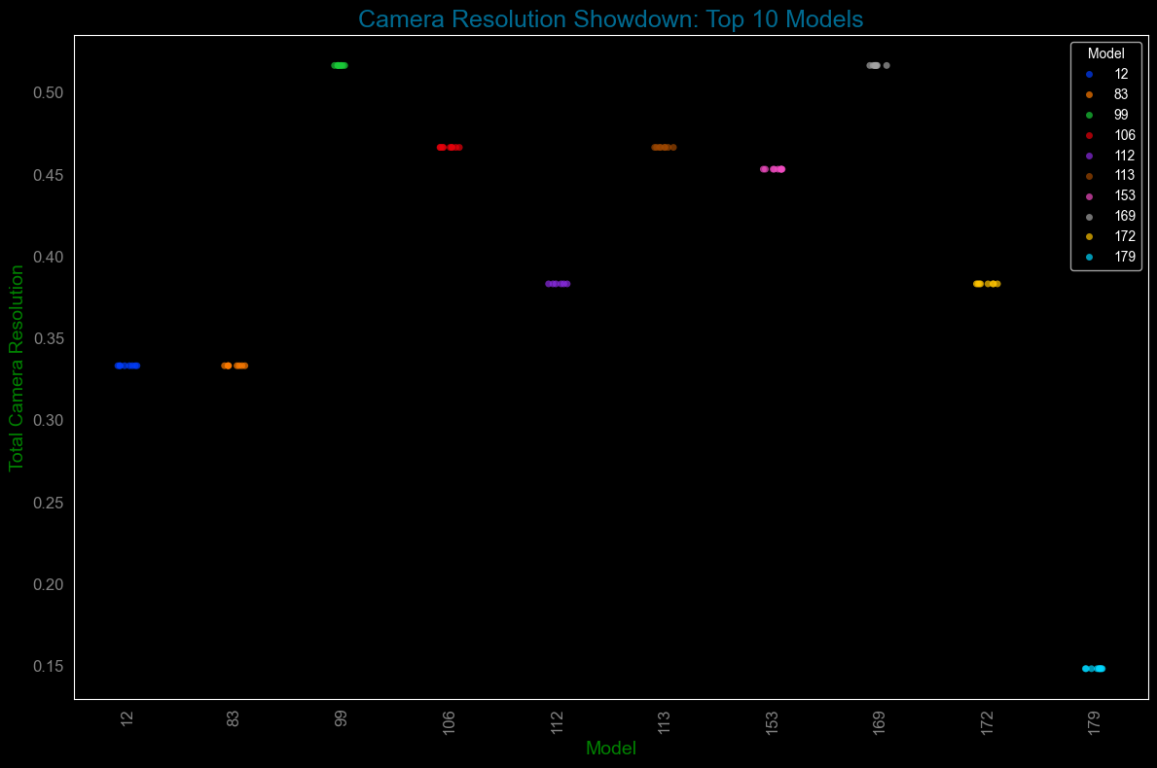
Total Camera Resolution of Models
Top-performing models: Redmi Note 12 Pro 5G and Vivo T1 44W have the highest camera resolutions.
Samsung's consistency: Samsung Galaxy F14 5G and Samsung Galaxy A14 5G have similar camera resolutions, ranking third and fourth, respectively.
Mid-range performers: Realme C55, Samsung Galaxy F13, and Vivo T2X 5G have moderate camera resolutions.
Lower-end models: Infinix Hot 30i, Redmi 10, and Vivo Y16 have lower camera resolutions, with Vivo Y16 being the lowest.

Slide 15
Conclusion
In conclusion, analysis reveals that:-
Total Memory is a key driver of price, with a strong positive correlation between the two.
Total Camera Resolution is also an important feature that affects price.
AI Lens is a cost-effective feature that does not significantly impact price.
Mid-range models offer a balance between features and price, making them an attractive option for consumers.
These findings provide valuable insights for manufacturers and consumers, highlighting the importance of considering key features when making pricing decisions or purchasing handsets

Slide 16
THANK YOU

